Slide 1
Miscellaneous topics
SAD301

Slide 2
Systems Development Life Cycle
Strengths
Control.
Monitor large projects.
Detailed steps.
Evaluate costs and completion targets.
Documentation.
Well defined user input.
Ease of maintenance.
Development and design standards.
Tolerates changes in MIS staffing.
Weaknesses
Increased development time.
Increased development cost.
Systems must be defined up front.
Rigidity.
Hard to estimate costs, project overruns.
User input is sometimes limited.

Slide 3
Introduction
For fact finding, People will inevitably experience situations in which one-on-one interviews do not seem to be as useful as you would like.
Why ?
Personal interviews are time consuming and subject to error, and
Their data are prone to misinterpretation
So we need some alternative .
Solution : JAD (Joint Application Design)
Developed by IBM

Slide 4
Joint Application Development (JAD)
JAD is a modern method of requirements gathering that brings owners, users, analysts, designers, and builders to define and design the system using organized and intensive workshops.
JAD trained analyst act as facilitator for workshop who has some specialized skills.
JAD can be a very effective method for reducing the time required to accomplish requirements analysis.
Depending on the size of the project, a JAD workshop can take anywhere from one day to a couple of weeks.

Slide 5
Joint Application Development (JAD)
The motivation for using JAD is –
to cut the time (and hence the cost) required by personal interviews,
to improve the quality of the results of information requirements assessment, and
to create more user identification with new information systems as a result of the participative processes.
it has usually been employed as a technique that allows a systems analyst, to accomplish requirements analysis and to design the user interface jointly with users in a group setting.

Slide 6
Conditions That Support the Use of JAD
The following list of conditions will help you decide when the use of JAD may be fruitful. Consider using joint application design when:
User groups are restless and want something new, not a standard solution to a typical problem.
The organizational culture supports joint problem-solving behaviors among multiple levels of employees.
Analysts forecast that the number of ideas generated via one-on-one interviews will not be as plentiful as the number of ideas possible from an extended group exercise.
Organizational workflow permits the absence of key personnel during a two-to-four-day block of time.

Slide 7
Joint Application Development (JAD)
The JAD process is based on four simple ideas-
People who actually do a job have the best understanding of the job
People who are trained in information technology have the best understanding of the possibilities of that technology.
Information systems never exist alone
The best results are obtained when all these groups work together on a project.

Slide 8
Participants
Joint application design sessions include a variety of participants—
analysts, users, executives, and so on
Primary concern here is that all project team members are committed to the JAD approach and become involved.

Slide 9
Considerations about choosing participants
An executive sponsor, a senior person should be chosen who will introduce and conclude the JAD session.
An executive should be selected from the user group who has some sort of authority over the IS people working on the project.
At least one IS analyst should be present,
usually takes a passive role, unlike traditional interviewing in which the analyst controls the interaction.
Why ?
to listen to what users say and what they require.
In addition, to give an expert opinion about any disproportionate costs of solutions proposed during the JAD session itself to avoid unrealistic solutions with excessive costs

Slide 10
Considerations about choosing participants
Users who can articulate
what information they need to perform their jobs as well as
what they desire in a new or improved computer system.
The session leader should be someone who has excellent communication skills to facilitate appropriate interactions.
He may not be an expert in systems analysis and design.
Should also include one or two observers
from other functional areas
to offer technical explanations and advice to the group during the sessions.
May be analysts or technical experts
One scribe from the IS department to formally write down everything that is done.

Slide 11
Where to Hold JAD Meetings
If at all possible, it is recommended to holding the two-to-four-day sessions off-site, away from the organization, in comfortable surroundings.
The idea is to minimize the daily distractions and responsibilities of the participants’ regular work.
JAD session should be scheduled when all participants can commit to attending.
This rule is critical to the success of the sessions.

Slide 12
Where to Hold JAD Meetings
Be ensured that all participants receive an agenda before the meeting, and
Holding an orientation meeting for a half day one week or so before the workshop so that those involved know what is expected of them.
Such a premeeting allows participants to move rapidly and act confidently once the actual meeting is convened.

Slide 13
Accomplishing a Structured Analysis of Project Activities
IBM recommends that the JAD sessions examine these points in the proposed systems project:
planning, receiving, receipt processing/tracking, monitoring and assigning, processing, recording, sending, and evaluating.
For each topic, the questions who, what, how, where, and why should also be asked and answered.
The analyst involved with the JAD sessions,
receive the notes of the scribe and
prepare a specifications document based on what happened at the meeting.
the management objectives as well as the scope and boundaries of the project should be presented Systematically
Specifics of the system, including details on screen and report layouts, should also be included.

Slide 14
Guidelines for a Successful JAD
Questions to ask
Are your meetings well attended?
Are all affected parties involved/aware of decisions being made?
Did you solve the true underlying problem?
Is your solution accepted and used by your clients?
Is the solution available on time?

Slide 15
Guidelines for a Successful JAD :Pitfalls:
Sponsor not really committed - no resources
Unclear goals or objectives - lack of direction
Too many or too few members
Not enough communication with outsiders affected by decisions
Timelines aren't kept
Project Creep - project grows beyond the original definition and scope
Meetings aren't well facilitated
Feels like nothing is accomplished in the meeting - old items not within scope keep getting revisited over and over
1 or 2 members dominate discussions

Slide 16
Advantages of JAD
It saves time and cost by replacing months of traditional interviews and follow-up meetings.
It is useful in organizational culture which supports joint problem solving.
Fosters formal relationships among multiple levels of employees.
It can lead to development of design creatively.
It Allows rapid development and improves ownership of information system.

Slide 17
Disadvantages of JAD
Requires the commitment of a large block of time from all participants.
If preparation for the JAD sessions is inadequate in any regard or if the follow-up report and documentation of specifications is incomplete, designs could be less than satisfactory.
Many variables need to come together correctly for JAD to be successful
The success of designs resulting from JAD sessions is less predictable than that achieved through standard interviews.
The necessary organizational skills and organizational culture may not be sufficiently developed to enable the concerted effort required to be productive in a JAD setting.

Slide 18
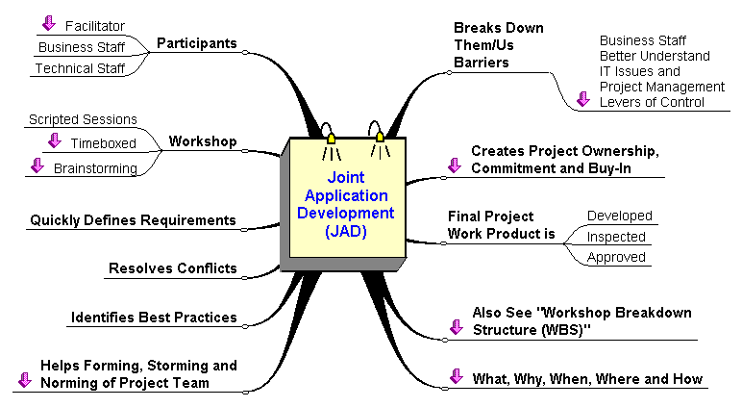
JAD in one diagram

